Slide 1
Machine Learning With Python
Nabajyoti Pathak

Slide 2
Agenda
Clustering
K Means Clustering
Hierarchical Clustering
Difference between K Means and Hierarchical clustering
Applications of Clustering
Improving Supervised Learning algorithms with clustering
Cluster Validity

Slide 3
Overview
Clustering is the task of dividing the population or data points into a number of groups such that data points in the same groups are more similar to other data points in the same group than those in other groups.
In simple words, the aim is to segregate groups with similar traits and assign them into clusters.

Slide 4
Example
Suppose, you are the head of a rental store and wish to understand preferences of your costumers to scale up your business.
Is it possible for you to look at details of each costumer and devise a unique business strategy for each one of them?
But, what you can do is to cluster all of your costumers into say 10 groups based on their purchasing habits and use a separate strategy for costumers in each of these 10 groups. And this is what we call clustering.

Slide 5
Types of Clustering
Hard Clustering: In hard clustering, each data point either belongs to a cluster completely or not. For example, in the above example each customer is put into one group out of the 10 groups.
Soft Clustering: In soft clustering, instead of putting each data point into a separate cluster, a probability or likelihood of that data point to be in those clusters is assigned. For example, from the above scenario each costumer is assigned a probability to be in either of 10 clusters of the retail store.

Slide 6
Type of Clustering(Based on Separation)
Partitioning Algorithms
constructs k partitions of the n data/objects where each partition represents a cluster and k≤n
divides the data into k groups such that
each cluster must contain at least one object, and
each object must belong to exactly one cluster
as the number of clusters k are given, the algorithm creates an initial partitioning

Slide 7
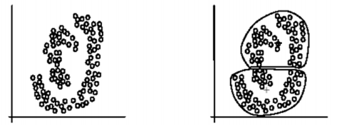
Type of Clustering
Density based Algorithms
Grow the cluster as long as density in the neighborhood exceeds some threshold
partitioning methods can find only spherical shaped clusters
difficult to cluster complicated structures of data using partitioning

Slide 8
Types of Clustering
Hierarchical Algorithms:-
creating hierarchical decomposition of the given set of data/objects
agglomerative (bottom-up): starts with each object as a distinct cluster. Merges the clusters or objects based on the similarity metrics until all of the clusters are merged into one
divisive (top-down): starts with all the objects in the same cluster. The groups are split up into smaller clusters, until each object forms distinct clusters

Slide 9
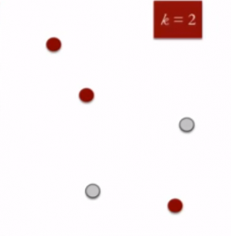
K Means Clustering
K means is an iterative clustering algorithm.
This algorithm works in these 5 steps
Specify the desired number of clusters K : Let us choose k=2 for these 5 data points in 2-D space.

Slide 10

STEP2
Randomly assign each data point to a cluster : Let’s assign three points in cluster 1 shown using red color and two points in cluster 2 shown using grey color.

Slide 11
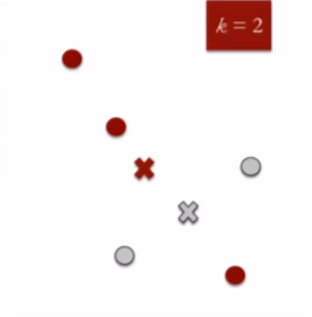
Step3
Compute cluster centroids : The centroid of data points in the red cluster is shown using red cross and those in grey cluster using grey cross.

Slide 12
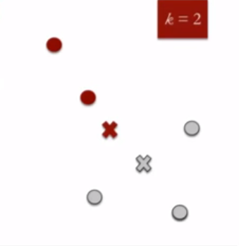
Step4
Re-assign each point to the closest cluster centroid :
Note that only the data point at the bottom is assigned to the red cluster even though its closer to the centroid of grey cluster.
Thus, we assign that data point into grey cluster

Slide 13
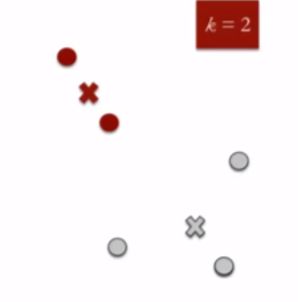
Step5
Re-compute cluster centroids :
Now, re-computing the centroids for both the clusters.

Slide 14
Step6
Repeat steps 4 and 5 until no improvements are possible :
Similarly, we’ll repeat the 4th and 5th steps until we’ll reach global optima.
When there will be no further switching of data points between two clusters for two successive repeats.
It will mark the termination of the algorithm if not explicitly mentioned.

Slide 15
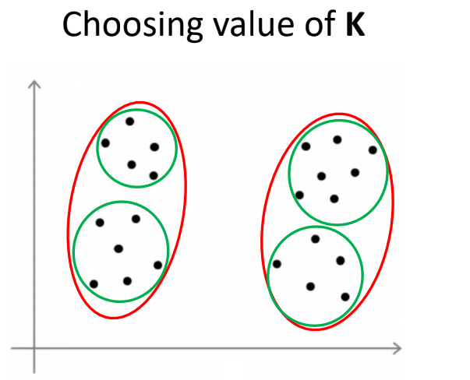

Slide 16
Elbow method for determining K
Compute the Cost function J / Distortion for each value of K
The plot of Cost function J v/s Number of cluster K looks like an arm for clustered data
The "elbow" on the arm is the best value of K
Cost Function J will decrease towards 0 as we increase the value of K
Aim is to find a small value of K that has a lower cost
Elbow method do not work well if the data is not very clustered

Slide 17
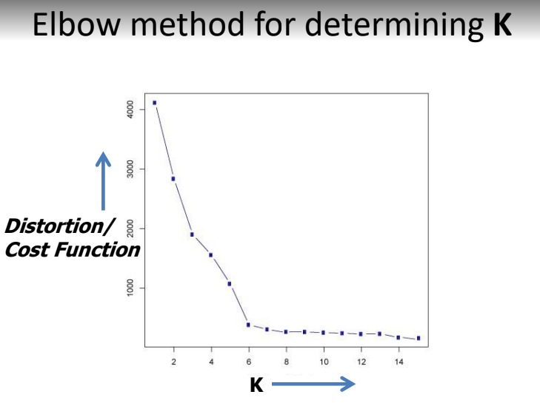

Slide 18
K-Means
K-means is the most popular clustering algorithm
Simple: implementation and understanding
Efficiency: O(tKm),
where m is the number of data points
K is the number of clusters, and
t is the number of iterations.
The grouping is done by minimizing the sum of squares of distances between data and the corresponding cluster centroid

Slide 19
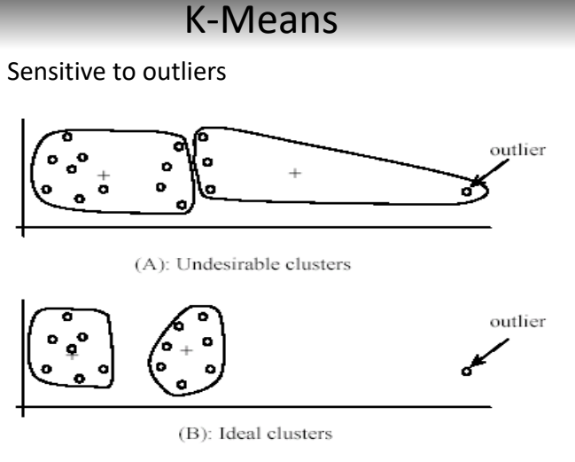

Slide 20
Hierarchical Clustering
Hierarchical clustering, as the name suggests is an algorithm that builds hierarchy of clusters.
This algorithm starts with all the data points assigned to a cluster of their own.
Then two nearest clusters are merged into the same cluster.
In the end, this algorithm terminates when there is only a single cluster left.

Slide 21
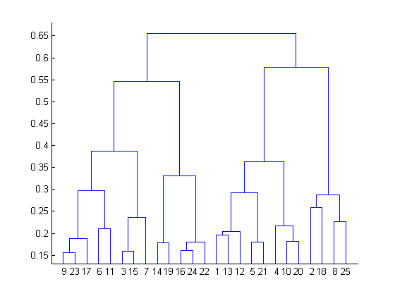
Dendrogram
The results of hierarchical clustering can be shown using dendrogram.
The dendrogram can be interpreted as:

Slide 22
Dendogram
At the bottom, we start with 25 data points, each assigned to separate clusters. Two closest clusters are then merged till we have just one cluster at the top. The height in the dendrogram at which two clusters are merged represents the distance between two clusters in the data space.
The decision of the no. of clusters that can best depict different groups can be chosen by observing the dendrogram. The best choice of the no. of clusters is the no. of vertical lines in the dendrogram cut by a horizontal line that can transverse the maximum distance vertically without intersecting a cluster.

Slide 23
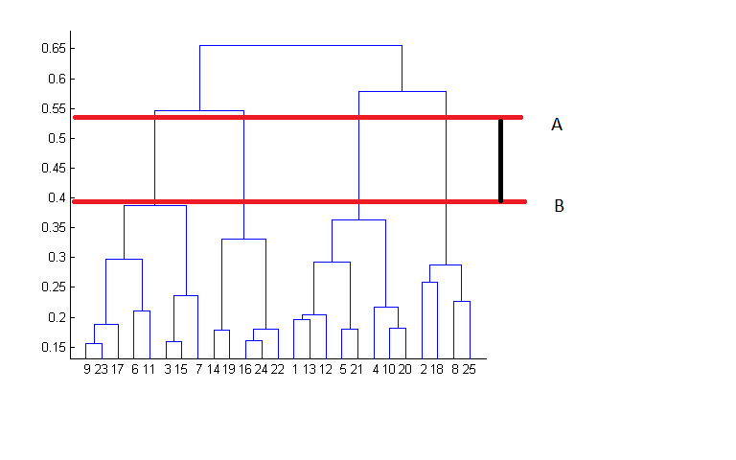

Slide 24
Difference between K Means and Hierarchical clustering
Hierarchical clustering can’t handle big data well but K Means clustering can. This is because the time complexity of K Means is linear i.e. O(n) while that of hierarchical clustering is quadratic i.e. O(n²).
In K Means clustering, since we start with random choice of clusters, the results produced by running the algorithm multiple times might differ. While results are reproducible in Hierarchical clustering.
K Means is found to work well when the shape of the clusters is hyper spherical (like circle in 2D, sphere in 3D).
K Means clustering requires prior knowledge of K i.e. no. of clusters you want to divide your data into. But, you can stop at whatever number of clusters you find appropriate in hierarchical clustering by interpreting the dendrogram

Slide 25
Applications of Clustering
Clustering has a large no. of applications spread across various domains. Some of the most popular applications of clustering are:
Recommendation engines
Market segmentation
Social network analysis
Search result grouping
Medical imaging
Image segmentation
Anomaly detection

Slide 26
Improving Supervised Learning Algorithms with Clustering
Clustering is an unsupervised machine learning approach, but it can be used to improve the accuracy of supervised machine learning algorithms as well by clustering the data points into similar groups and using these cluster labels as independent variables in the supervised machine learning algorithm

Slide 27
Clustering Validity??
For supervised classification we have a variety of measures to evaluate how good our model is Accuracy, precision, recall
For cluster analysis, the analogous question is how to evaluate the “goodness” of the resulting clusters?

Slide 28
Different Aspects of Cluster Validation
Determining the clustering tendency of a set of data, i.e., distinguishing whether non-random structure actually exists in the data.
Comparing the results of a cluster analysis to externally known results, e.g., to externally given class labels.
Evaluating how well the results of a cluster analysis fit the data without reference to external information.
- Use only the data
Comparing the results of two different sets of cluster analyses to determine which is better.
Determining the ‘correct’ number of clusters.

Slide 29
Measures of Cluster Validity
Numerical measures that are applied to judge various aspects of cluster validity, are classified:-
Internal Index: Used to measure the goodness of a clustering structure without respect to external information.
Sum of Squared Error (SSE)

Slide 30
Internal Measures: SSE
Clusters in more complicated figures aren’t well separated.
Internal Index: Used to measure the goodness of a clustering structure without respect to external information
SSE
SSE is good for comparing two clusterings or two clusters (average SSE).
Can also be used to estimate the number of clusters

Slide 31
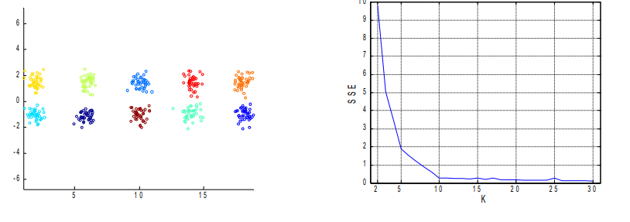
Number of Clusters

Slide 32
Quiz K- means
K-Means is which type of learning algorithm?
K-Means squared error function is related with which of the following?
a. Euclidean distance b. Hamming distance c. Manhattan distance
K-Means can be used to solve problems?
In K-Means, K stands for __________
The goal for K-Means cost function is to ________ squared error function where error function represents distance between data points and cluster centroid
K-means algorithm can be used for which of the following?
a. Cluster analysis b. Feature learning c. Both
Which of the following algorithm has similarity with K-Means?
Support vector machine
Logistic regression
Linear regression
K-NN

Slide 33


